Slide 1
Brute Force II

Slide 2
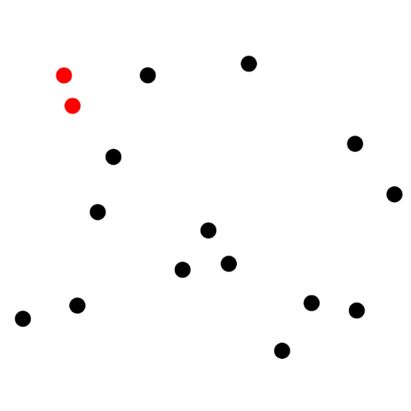
Lab 5: Mock Interview
Work in pairs: 1 person is interviewer, 1 person is candidate
Candidate writes pseudo-code on the board
Interviewer asks questions to help interviewee improve their pseudo-code
Problem: Opposites Don’t Attract
You are writing an online dating match algorithm.
Notes:
Introduce Selves

Slide 3
What is Brute Force?
“Brute Force is a straightforward approach to solving a problem, usually directly based on the problem statement and definitions of the concepts involved.”
Notes:
Example: computing a^n by multiplying n times.

Slide 4
Brute Force Approaches to …
Last Time:
Sorting
Searching
String Matching
Geometric Problems
Closest Pair
Today:
Geometric Problems
Convex Hull
Combinatorial Problems
Travelling Salesman Problem
Knapsack Problem
Assignment Problem
Graph Problems

Slide 5
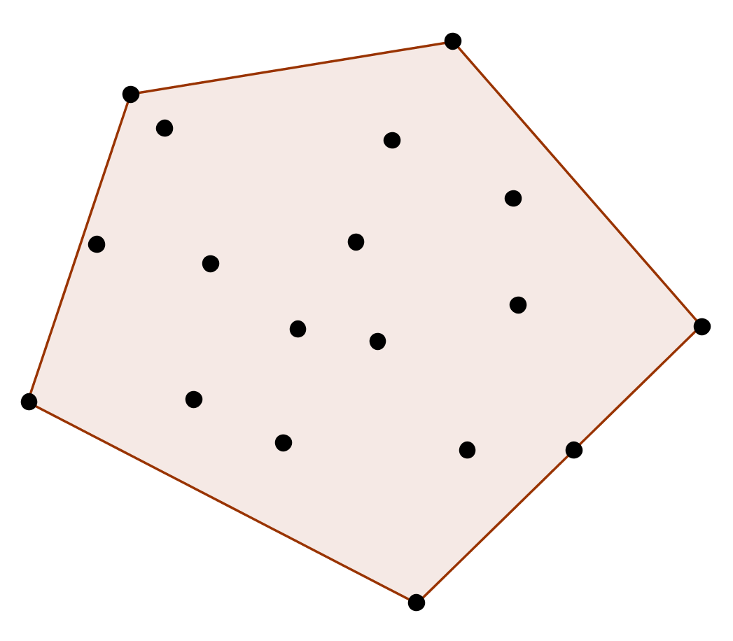
Convex Hull
Given set of points S, find the subset of S that forms a convex hull enclosing all the points in S.

Slide 6
Brute Force Convex Hull
Test each pair of points to see if line segment between them is part of convex hull.
i.e. whether all other points lie to one side of it.
Given two points (x₁,y₁) (x₂,y₂), line between them is: ax + by = c
a = y₂-y₁, b = x₁-x₂, c = x₁y₂-y₁x₂
O(n³)

Slide 7
Combinatorial Problems

Slide 8
Combinatorial Problems
Find an element with given property in domain that grows exponentially (or worse) with instance size.
What would be a brute force approach?
Common in Optimization problems.

Slide 9
Traveling Salesman (TSP)
Find the shortest tour through n cities that visits each city exactly once before returning to the city where it started.
a
2
b
7
5
3
8
c
d
1

Slide 10
Traveling Salesman (TSP)
What are all possible tours starting at a?
How many are there (as function of n)?
Which is the shortest?
a
2
b
7
5
3
8
c
d
1

Slide 11
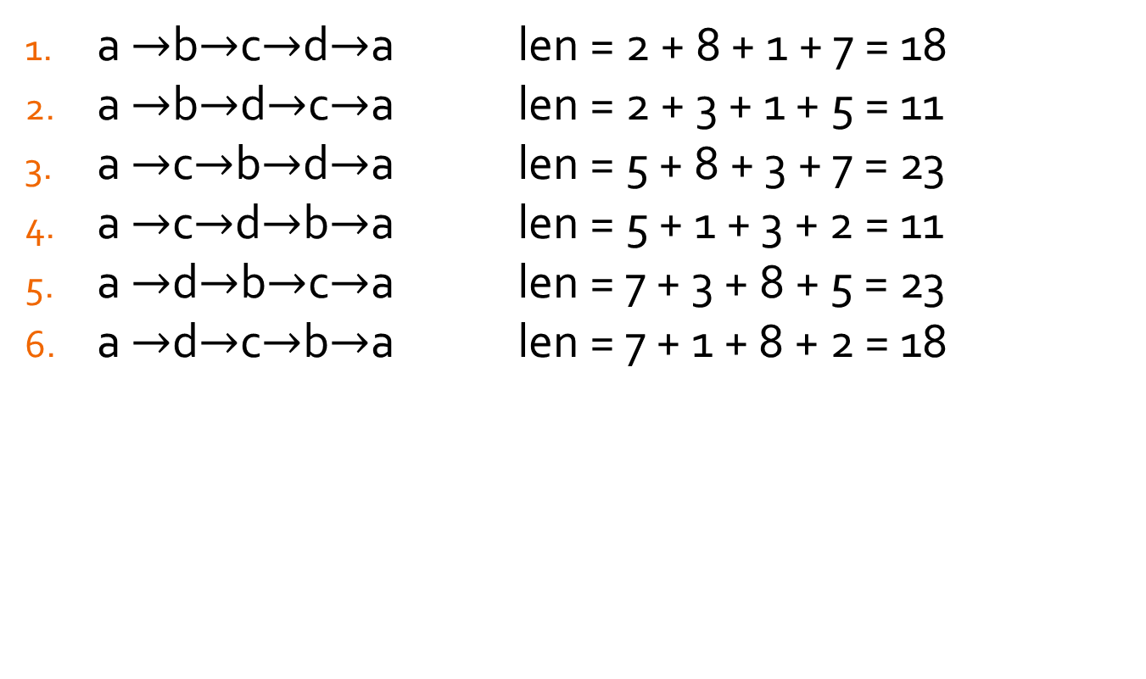
Traveling Salesman (TSP)
a $→$b$→$c$→$d$→$a len = 2 + 8 + 1 + 7 = 18
a $→$b$→$d$→$c$→$a len = 2 + 3 + 1 + 5 = 11
a $→$c$→$b$→$d$→$a len = 5 + 8 + 3 + 7 = 23
a $→$c$→$d$→$b$→$a len = 5 + 1 + 3 + 2 = 11
a $→$d$→$b$→$c$→$a len = 7 + 3 + 8 + 5 = 23
a $→$d$→$c$→$b$→$a len = 7 + 1 + 8 + 2 = 18
Notice the repetition -- one for each direction.
a
2
b
7
5
3
8
c
d
1

Slide 12
Traveling Salesman (TSP)
a $→$b$→$c$→$d$→$a len = 2 + 8 + 1 + 7 = 18
a $→$b$→$d$→$c$→$a len = 2 + 3 + 1 + 5 = 11
a $→$c$→$b$→$d$→$a len = 5 + 8 + 3 + 7 = 23
a $→$c$→$d$→$b$→$a len = 5 + 1 + 3 + 2 = 11
a $→$d$→$b$→$c$→$a len = 7 + 3 + 8 + 5 = 23
a $→$d$→$c$→$b$→$a len = 7 + 1 + 8 + 2 = 18
a
2
b
Choose 2 intermediate states, e.g. b,c and then force them to be in alphabetical order.
Did the Big-O change?
7
5
3
8
c
d
1

Slide 13
Knapsack Problem
You have a set of n items with weights w₁, w₂, …, w_{n} and values v₁, v₂, …, v_{n}. You have a knapsack that can hold a total weight of W. What’s the most valuable subset of items you can fit in the knapsack?
W = 10
w₁ = 7
v₁ = $42
w₄ = 5
v₄ = $25
w₃ = 4
v₃ = $40
w₂ = 3
v₂ = $12

Slide 14
Knapsack Problem
Subset | Total Weight | Total Value
{ } | 0 | $0
{1} | 7 | $42
{2} | 3 | $12
{3} | 4 | $40
{4} | 5 | $25
{1,2} | 10 | $54
{1,3} | 11 | not feasible
{1,4} | 12 | not feasible
{2,3} | 7 | $52
{2,4} | 8 | $37
{3,4} | 9 | $65
{1,2,3} | 14 | not feasible
{1,2,4} | 15 | not feasible
{1,3,4} | 16 | not feasible
{2,3,4} | 12 | not feasible
{1,2,3,4} | 19 | not feasible

Slide 15
Knapsack Problem
How many subsets exist in a set of n items?
Imagine representing subset with bit string – 1 means item is in subset, 0 means item is not in subset.
How many numbers can be represented with n bits of a binary representation?
1 | 2 | 3 | 4
0 | 1 | 1 | 0

Slide 16
Knapsack Problem
How many subsets exist in a set of n items?
Imagine representing subset with bit string – 1 means item is in subset, 0 means item is not in subset.
How many numbers can be represented with n bits of a binary representation? 2^{n}
Example of NP-Hard problem
1 | 2 | 3 | 4
0 | 1 | 1 | 0

Slide 17
Remember!
 | log₂n | n | n log₂n | n² | n³ | 2^{n} | n!
10 | 3.3 | 10 | 33 | 10² | 10³ | 10³ | 10⁶
10² | 6.6 | 10² | 660 | 10⁴ | 10⁶ | 1.3 ∙ 10³⁰ | 9.3 ∙ 10¹⁵⁷
10³ | 10 | 10³ | 10⁴ | 10⁶ | 10⁹
10⁴ | 13 | 10⁴ | 1.3 ∙ 10⁵ | 10⁸ | 10¹²
10⁵ | 17 | 10⁵ | 1.7 ∙ 10⁶ | 10¹⁰ | 10¹⁵
10⁶ | 20 | 10⁶ | 2.0 ∙ 10⁷ | 10¹² | 10¹⁸
Longer than age of universe!!

Slide 18
Exhaustive Search
Brute Force approach to Combinatorial Problems
Generate each and every element in problem domain.
Select those that satisfy the required constraints.
Choose the one that optimizes the relevant objective function.
Depth-First and Breadth-First Search
Useful for graph problems in AI and OR

Slide 19
Depth First Search (DFS)
View graph as a tree, rooted at arbitrary starting node:
a
c
b
e
d
f

Slide 20
Depth First Search (DFS)
a
Start at arbitrary vertex
Each iteration, proceed to an unvisited vertex – if there are multiple, break tie arbitrarily
Upon reaching a dead end, back up.
If back up to start node, no solution exists.
b
d
e
f
c

Slide 21
Depth First Search (DFS)
a
Keep track of nodes to explore on a stack (LIFO)
b
d
e
f
c

Slide 22
Depth First Search (DFS)
a
Start at arbitrary vertex
Each iteration, proceed to an unvisited vertex – if there are multiple, break tie arbitrarily
Upon reaching a dead end, back up.
If back up to start node, no solution exists.
a

Slide 23
Depth First Search (DFS)
a
Start at arbitrary vertex
Each iteration, proceed to an unvisited vertex – if there are multiple, break tie arbitrarily
Upon reaching a dead end, back up.
If back up to start node, no solution exists.
b
b
a

Slide 24
Depth First Search (DFS)
a
Start at arbitrary vertex
Each iteration, proceed to an unvisited vertex – if there are multiple, break tie arbitrarily
Upon reaching a dead end, back up.
If back up to start node, no solution exists.
b
d
d
b
a

Slide 25
Depth First Search (DFS)
a
Start at arbitrary vertex
Each iteration, proceed to an unvisited vertex – if there are multiple, break tie arbitrarily
Upon reaching a dead end, back up.
If back up to start node, no solution exists.
b
d
b
a

Slide 26
Depth First Search (DFS)
a
Start at arbitrary vertex
Each iteration, proceed to an unvisited vertex – if there are multiple, break tie arbitrarily
Upon reaching a dead end, back up.
If back up to start node, no solution exists.
b
d
e
e
b
a

Slide 27
Depth First Search (DFS)
a
Start at arbitrary vertex
Each iteration, proceed to an unvisited vertex – if there are multiple, break tie arbitrarily
Upon reaching a dead end, back up.
If back up to start node, no solution exists.
b
d
e
f
f
e
b
a

Slide 28
Depth First Search (DFS)
a
Start at arbitrary vertex
Each iteration, proceed to an unvisited vertex – if there are multiple, break tie arbitrarily
Upon reaching a dead end, back up.
If back up to start node, no solution exists.
b
d
e
f
e
b
a

Slide 29
Depth First Search (DFS)
a
Start at arbitrary vertex
Each iteration, proceed to an unvisited vertex – if there are multiple, break tie arbitrarily
Upon reaching a dead end, back up.
If back up to start node, no solution exists.
b
d
e
c
f
e
b
c
a

Slide 30
DFS Algorithm
# Stack Structure Implicit: Uses Call Stack
count ← 0 // global var
DFS(G)
// Input: graph G = <V,E>
mark each vertex in V with 0 // unvisited
for each vertex v in V do
if v is marked with 0
dfs(v)
dfs(v)
count ← count + 1
mark v with count
for each vertex w adjacent to v do
if w is marked with 0
dfs(w)

Slide 31
DFS Properties
a
Efficiency:
O( |V|² ) for adjacency matrix
O( |V| + |E| ) for adjacency list
b
d
e
f
c

Slide 32
DFS Properties
a
Categorize Edges:
tree edge: one used to arrive at vertex (solid)
back edge: edge to other ancestor (dotted)
Graph properties: connected? acyclic?
How relate tree vs. back edges?
b
d
e
f
c

Slide 33
Breadth First Search (BFS)
a
Start at arbitrary vertex
Visit all nodes adjacent to starting node …
Then all unvisited nodes two hops from starting node …
Then three …
Best represented as a queue (FIFO)
d
b
c
e
f

Slide 34
Breadth First Search (BFS)
a
Start at arbitrary vertex
Visit all nodes adjacent to starting node …
Then all unvisited nodes two hops from starting node …
Then three …
d
b
c
a
b
c
d

Slide 35
Breadth First Search (BFS)
a
Start at arbitrary vertex
Visit all nodes adjacent to starting node …
Then all unvisited nodes two hops from starting node …
Then three …
d
b
c
e
b
c
d
e

Slide 36
Breadth First Search (BFS)
a
Start at arbitrary vertex
Visit all nodes adjacent to starting node …
Then all unvisited nodes two hops from starting node …
Then three …
d
b
c
e
f
c
d
e
f

Slide 37
Breadth First Search (BFS)
a
Start at arbitrary vertex
Visit all nodes adjacent to starting node …
Then all unvisited nodes two hops from starting node …
Then three …
d
b
c
e
f
d
e
f

Slide 38
Breadth First Search (BFS)
a
Start at arbitrary vertex
Visit all nodes adjacent to starting node …
Then all unvisited nodes two hops from starting node …
Then three …
d
b
c
e
f
e
f

Slide 39
Breadth First Search (BFS)
a
Start at arbitrary vertex
Visit all nodes adjacent to starting node …
Then all unvisited nodes two hops from starting node …
Then three …
d
b
c
e
f
f

Slide 40
BFS Algorithm
count ← 0
q ← [] // empty queue
BFS(G)
mark each vertex in V with 0
for each vertex v in V do
if v is marked with 0
bfs(v)
bfs(v)
count ← count + 1
mark v with count and q.enqueue(v)
while q is not empty do
for each vertex w adjacent to v do
if w is marked with 0
count ← count + 1
mark w with count
q.enqueue(w)
q.dequeue()

Slide 41
BFS Properties
a
Efficiency:
O( |V|² ) for adjacency matrix
O( |V| + |E| ) for adjacency list
d
b
c
e
f

Slide 42
BFS Properties
a
Graph Properties:
Can also detect connected, acyclic
Can find shortest path between root and other vertex.
d
b
c
e
f

